Slide 1
Computer Network (CS3002)
Spring Semester (2021-2022)
Dr. Judhistir Mahapatro
Department of Computer Science and Engineering
National Institute of Technology Rourkela

Slide 2
The Network Layer

Slide 3
Quality of Service
Application requirements
Traffic shaping
Packet scheduling
Admission control
Integrated services
Differentiated services

Slide 4
Quality of Service
Four issues must be addressed to ensure quality of service:
  What applications need from the network.
  How to regulate the traffic that enters the network.
  How to reserve resources at routers to guarantee performance.
  Whether the network can safely accept more traffic.
No single technique deals efficiently with all these issues.

Slide 5
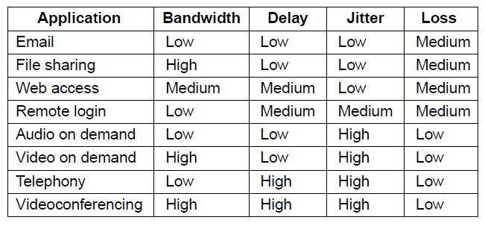
Application Requirements
How stringent the quality-of-service requirements are.
The variation (i.e., standard deviation) in the delay or packet arrival times is called jitter.

Slide 6
Categories of QoS and Examples
Constant bit rate
    Providing uniform bandwidth and delay.
    Telephony
Real-time variable bit rate
    Compressed videoconferencing
    Some frames compressing more than others.
Non-real-time variable bit rate
    Watching a movie on demand
    A few seconds of video can easily be buffered at the receiver before playback starts
Available bit rate
    File transfer, not sensitive to delay and jitter

Slide 7
Traffic Shaping
Traffic in data networks is bursty.
  Traffic arrives at nonuniform rates
Bursts of traffic are more difficult to handle than constant-rate traffic
  they can fill buffers and cause packets to be lost.
A technique for regulating the average rate and burstiness of a flow of data

Slide 8
Traffic Shaping
When a flow is set up, the user and the network agree on a certain traffic pattern (i.e., shape) for that flow.
  Customer says to the provider “My transmission pattern will look like this; can you handle it?”
    Sometimes this agreement is called an SLA (Service Level Agreement)

Slide 9
Traffic Shaping
Packets in excess of the agreed pattern
  might be dropped by the network, or
  they might be marked as having lower priority.
  Monitoring a traffic flow is called traffic policing.
Shaping and policing are of great importance for real-time data.
  Not so important for peer-to-peer and other transfers as they consume all available bandwidth

Slide 10
Traffic Shaping
The sliding window used to limit how much data is in transit at any given time
  indirectly limits the rate.
A more general way to characterize the traffic
  token bucket and
  leaky bucket algorithms.

Slide 11
Traffic Shaping
Conceptually, each host is connected to the network by an interface containing a leaky bucket.
  To send packets into the network, it must be possible to put more water into the bucket.
  If bucket is full, packet must either be queued until enough water leaks out to hold it or be discarded.
  This technique is called leaky bucket algorithm

Slide 12
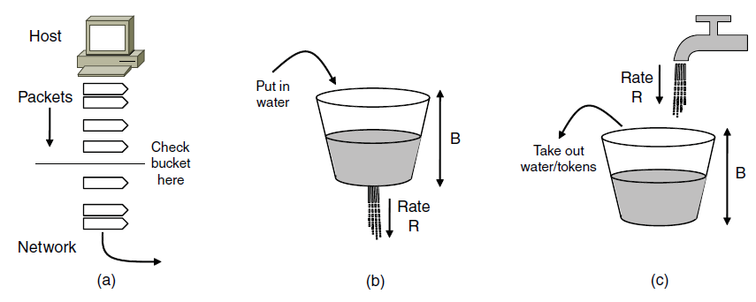
Traffic Shaping
(a) Shaping packets. (b) A leaky bucket. (c) A token bucket
Shaping packets
A leaky bucket
A token bucket

Slide 13
Traffic Shaping
If we call the burst length S sec., maximum output rate M bytes/sec, the token bucket capacity B bytes, and token arrival rate R bytes/sec, then
an output burst contains a maximum of B+RS bytes
We also know that the number of bytes in a maximum speed burst of length S seconds is MS
thus, B+RS = MS
Also, S = B/(M-R)

Slide 14
Packet Scheduling
Kinds of resources can potentially be reserved for different flows:
Bandwidth.
Buffer space.
CPU cycles.

Slide 15
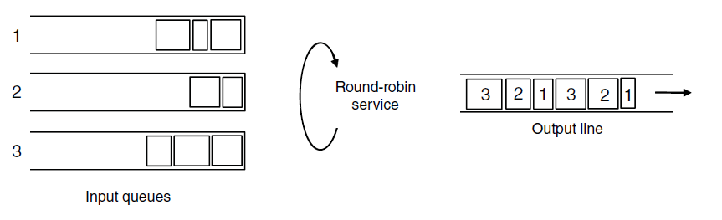
Packet Scheduling
Round-robin Fair Queuing

Slide 16
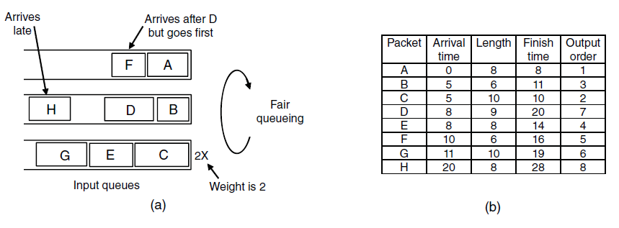
Packet Scheduling
Weighted Fair Queueing.
Finishing times for the packets.

Slide 17
Internetworking
How networks differ
How networks can be connected
Tunneling
Internetwork routing
Packet fragmentation

Slide 18
Internetworking
Implicitly assumed that there is a single homogeneous network, with each machine using the same protocol in each layer
        wildly optimistic
Two or more networks such as LANs, MANs, 802.11, 802.16 are connected to form an internetwork, or more simply an internet.

Slide 19
Internetworking
Bot Metcalfe postulated that the value of a network with N nodes is the number of connections that may be made between the nodes
    N² (Gilder, 1993)
      Large number of networks are more valuable than small networks

Slide 20
How Networks Differ
Differ in many ways,
  such as different modulation techniques or frame formats, are internal to the physical and data link layers.
  Instead, we see differences that can be exposed to the network layer.

Slide 21
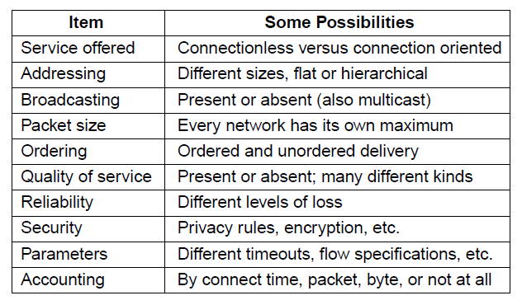
How Networks Differ
Some of the many ways networks can differ

Slide 22
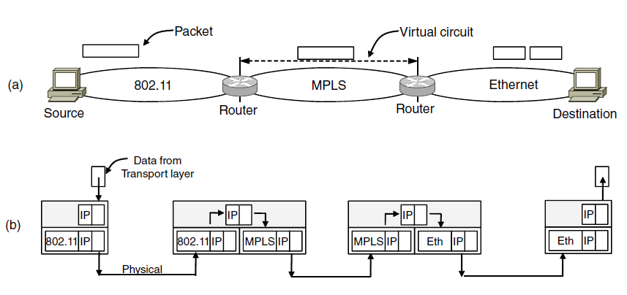
How Networks Can Be Connected
802.11 works with larger frames, so fragmentation is done here
Connectionless service
Connection-oriented
A packet crossing different networks.
(b) Network and link layer protocol processing.

Slide 23
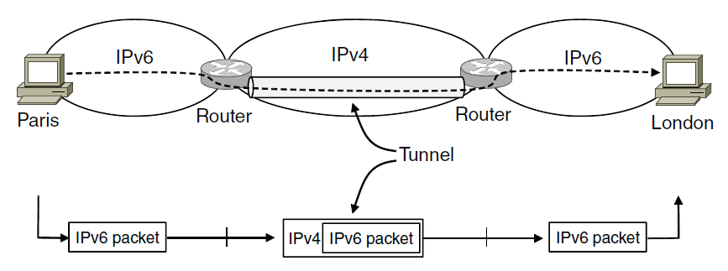
Tunneling
A router that can handle multiple network protocols is called multiprotocol router.
Making two different networks interwork is exceedingly difficult.
There is a common special case that is manageable even for different network protocols.
Tunneling a packet from Paris to London.

Slide 24
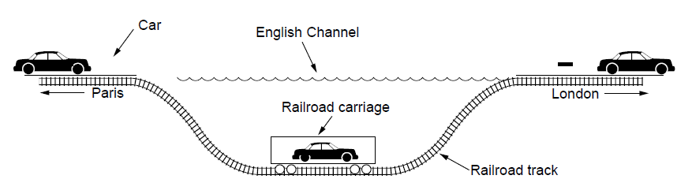
Tunneling
Tunneling a car from France to England
Disadvantage of tunneling is that none of the hosts on the network that is tunneled over can be reached because the packets cannot escape in the middle of the tunnel.
It is advantageous when used with VPNs.

Slide 25
Internetwork Routing
One network may use link state routing and other may use distance vector routing.
One operator want the route with least delay and another want the most inexpensive route.
Shortest paths on the internet will not be well defined.

Slide 26
Internetwork Routing
Operators may not want another operator even know the details of the path
  competitive business.
Routing algorithms that scale well by using hierarchy, even if none of the individual networks need to use a hierarchy.

Slide 27
Internetwork Routing
Two-level routing algorithms
  Within each network, an intradomain or interior gateway protocol is used for routing.
    Might be link state protocol kind
  Across the network, an interdomain or exterior gateway protocol is used.
    In the internet, BGP (Border Gateway Protocol) is used.

Slide 28
Packet Fragmentation
Packet size issues:
Hardware (e.g., size of the Ethernet frame)
Operating system (e.g., all buffers are 512 bytes)
Protocols (e.g., the number of bits in the packet length field)
Compliance with (inter)national standard.
Desire to Reduce error-induced retransmissions
Desire to prevent packet occupying channel too long.

Slide 29
Packet Fragmentation
Max payloads are
  1500 bytes for Ethernet
  2272 bytes for 802.11
  65,515 bytes for IP

Slide 30
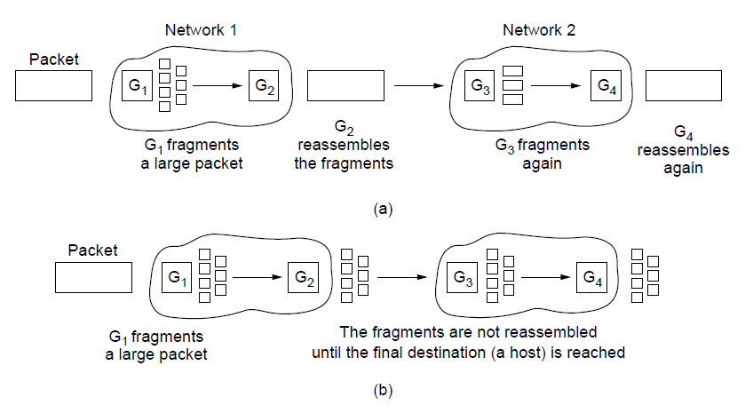
Packet Fragmentation
(a) Transparent fragmentation. (b) Nontransparent fragmentation

Slide 31
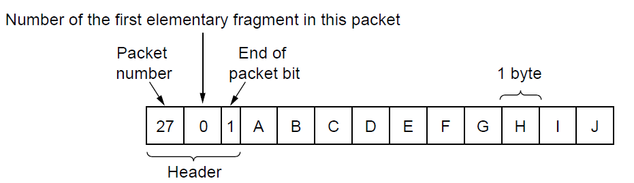
Packet Fragmentation
Fragmentation when the elementary data size is 1 byte.
(a) Original packet, containing 10 data bytes.

Slide 32
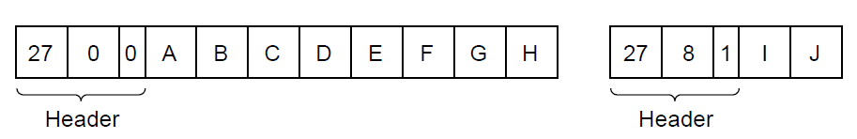
Packet Fragmentation
Fragmentation when the elementary data size is 1 byte
(b) Fragments after passing through a network
with maximum packet size of 8 payload bytes plus header.

Slide 33
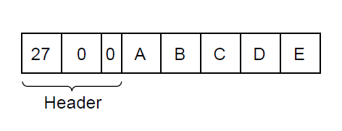
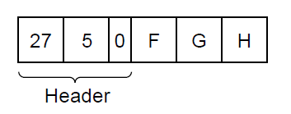
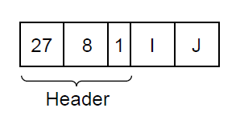
Packet Fragmentation
Fragmentation when the elementary data size is 1 byte
(c) Fragments after passing through a size 5 gateway.

Slide 34
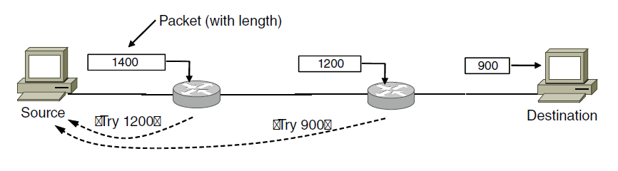
Packet Fragmentation
Path MTU Discovery

Slide 35
The Network Layer in the Internet
Top 10 principles:
Make sure it works
    Do not finalize the design or standard until multiple prototypes have successfully communicated with each other.
Keep it simple
    When in doubt, use the simplest solution.
Make clear choices
    If there are several ways of doing the same thing, choose one. Powerful parties insist that their way is best.

Slide 36
The Network Layer in the Internet
4. Exploit modularity
    Idea of having protocol stack
Expect heterogeneity
    Network design must be simple, general, and flexible to handle different types of hardware, transmission facility.
Avoid static options and parameters
    Negotiation between sender and receiver should be allowed (eg., maximum packet size)
Look for good design (not perfect)

Slide 37
The Network Layer in the Internet
8. Strict sending, tolerant receiving
    Sending comply with the standards
    Expect Incoming packets may not be fully conformant
9. Think about scalability
10. Consider performance and cost

Slide 38
The Network Layer in the Internet
The IP Version 4 Protocol
IP Addresses
IP Version 6
Internet Control Protocols
Label Switching and MPLS
OSPF—An Interior Gateway Routing Protocol
BGP—The Exterior Gateway Routing Protocol
Internet Multicasting
Mobile IP

Slide 39
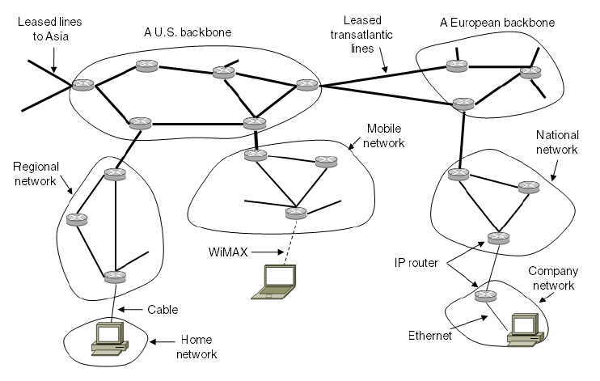
The Network Layer in the Internet
The Internet is an interconnected collection of many networks.

Slide 40
The IP Version 4 Protocol
An Ipv4 datagram consists of header part and a body or payload part.
Header has 20 byte fixed part and a variable-length optional part.

Slide 41
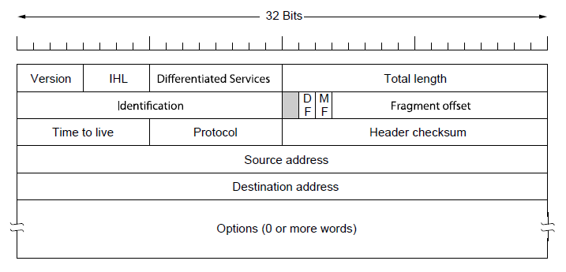
The IP Version 4 Protocol
The IPv4 (Internet Protocol) header.

Slide 42
The IP Version 4 Protocol
Version field version of the protocol the datagram belongs to.
IPv5 was an experimental real-time stream protocol that was never widely used.
IHL (4 bit field) is provided to tell how long the header is, in 32-bit words.

Slide 43
The IP Version 4 Protocol
Differentiated Service field
    3 bits to signal priority
    3 bits to signal whether a host care for delay, throughput, or reliability.
    When differentiated services were designed, top 6 bits are used to mark the packet with its service class
      Expedited and Assured Services classes.
    2 bits used to carry Explicit Congestion Notification information.

Slide 44
The IP Version 4 Protocol
Total Length include everything in the datagram-both header and data.
    Maximum length is 65,535 bytes.
Identification Field
    Determine which packet a newly arrived fragment belong to.
    All the fragments of a packet contain the same identification value.

Slide 45
The IP Version 4 Protocol
Unused bit (1bit)
DF
  Don’t fragment.
  It is used part of path MTU discovery process.
MF
  More fragments.
  Set all fragments except for the last.

Slide 46
The IP Version 4 Protocol
Fragment Offset
  Tells where in the current packet this fragment belongs.
  13-bits, there is a maximum of 8192 fragments per datagram supporting maximum packet length upto 65535 bytes.
  All fragments must be a multiple of 8 bytes, the elementary data units.

Slide 47
The IP Version 4 Protocol
TtL (Time to Live)
  Field is used to limit packet lifetime.
  Counter is used to count hops or count time in seconds
  Counter becomes zero, then source is warned.

Slide 48
The IP Version 4 Protocol
Protocol field
  Tells it which transport process to give the packet to.
  Ex: TCP, UDP are possibilities.
Header Checksum
  Used to compute the checksum to see any errors present
  Time to live field changes, every time it need to be computed.
Source and Destination Addresses

Slide 49
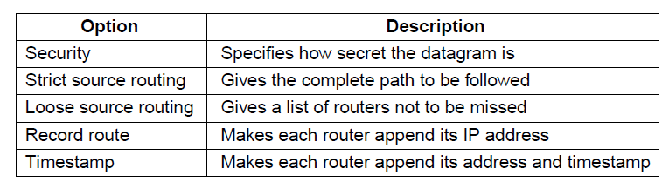
The IP Version 4 Protocol
Some of the IP options.

Slide 50
IP Addresses
Its 32-bit address.
Every host and Router on the Internet has an IP address.
It refers to a network interface actually not host.
A host on two networks, then it will have two IP addresses.
Routers have multiple IP addresses as they have multiple interfaces.

Slide 51
Prefixes
IP addresses are hierarchical, unlike Ethernet addresses.
It is comprised of a variable-length network portion and a host portion.
Network portion has the same value for all hosts on a single network, such as Ethernet LAN.
  This means that a network corresponds to a contiguous block of IP address space. This block is called a prefix.
It is written in dotted decimal notation.

Slide 52
Prefixes
Prefixes are written by giving the lowest IP address in the block and the size of the block.
  Size is the number of bits in the network portion.

Slide 53
Prefixes
If the prefix contains 2⁸ IP addresses and so leaves 24 bits for the network portion, it is written as 128.208.0.0/24
The length of the prefix corresponds to a binary mask of 1s in the network portion. This is called a subnet mask.
  It can be ANDed with the IP address to extract only the network portion.

Slide 54
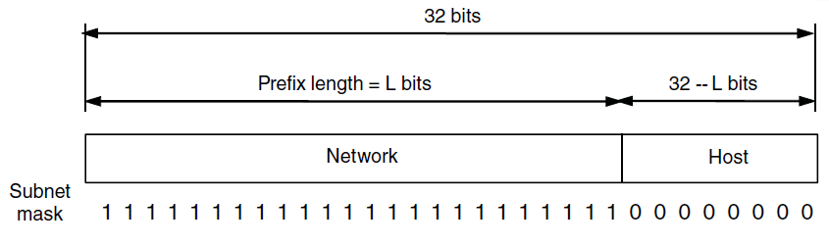
IP Addresses
An IP prefix.

Slide 55
Prefixes
Advantages of Hierarchical addresses is that routers can forward packets based on only the network portion of the address.
  Routers need to keep routes for only destined network routers not all of the hosts in the network.
  Routing tables much smaller than they would otherwise.

Slide 56
Prefixes
Disadvantages is that
    Ethernet address can be used anywhere but every IP address belongs to a specific network.
    Wasteful of addresses unless it is carefully managed.
      There will be many addresses that are allocated but not in use.

Slide 57
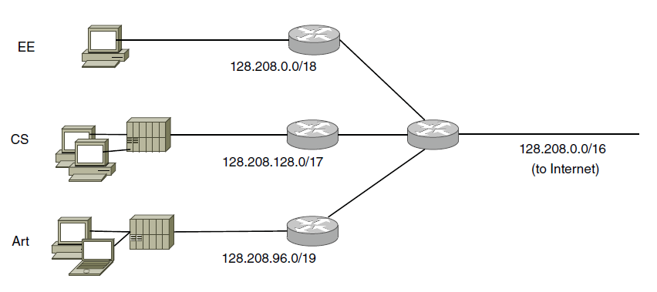
Subnets
Packet with destination address: 128.208.2.151
AND
Subnet mask
Splitting an IP prefix into separate networks with subnetting.

Slide 58
CIDR-Classless InterDomain Routing
There is something we can do to reduce routing table sizes.
  We can apply the same insight as subnetting.
  Instead splitting the address block, here we combine multiple small prefixes into a single larger prefix. This process is called route aggregation.
    The resulting larger prefix is sometimes called a supernet.

Slide 59
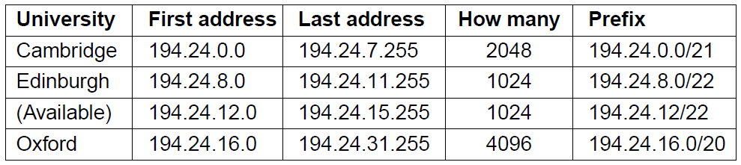
IP Addresses
A set of IP address assignments

Slide 60
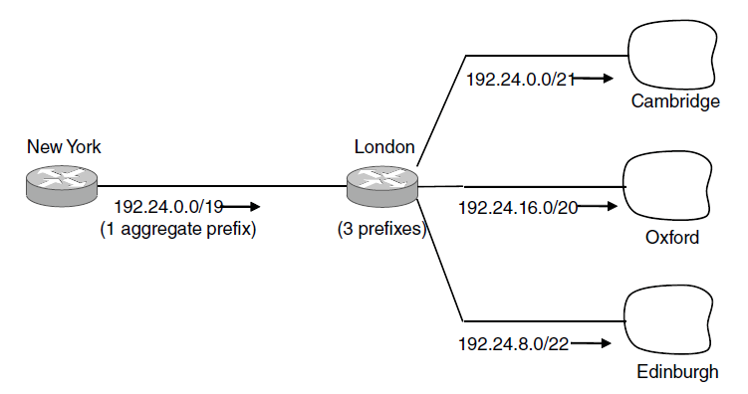
IP Addresses
Aggregation of IP prefixes

Slide 61
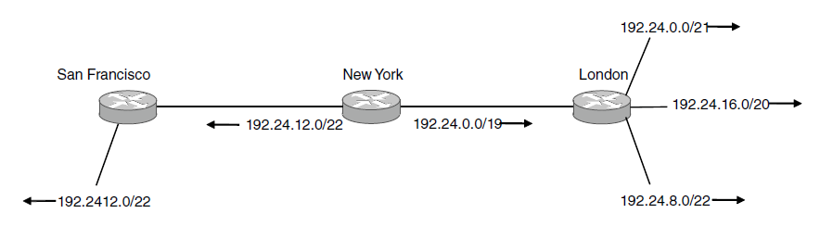
IP Addresses
Longest matching prefix routing at the New York router.

Slide 62
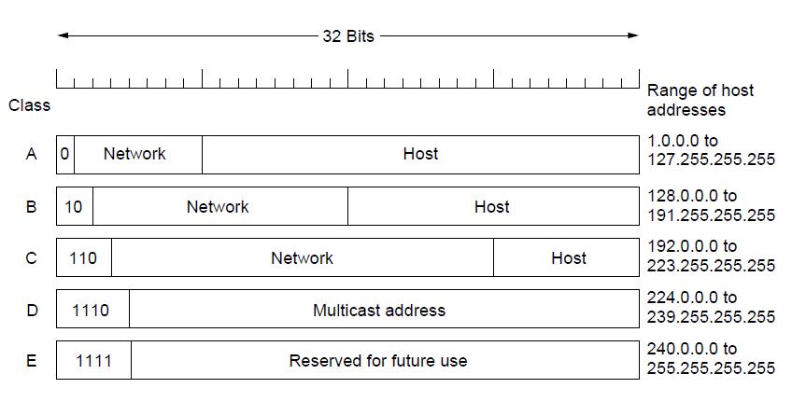
Classful and Special IP Addressing
IP address formats

Slide 63
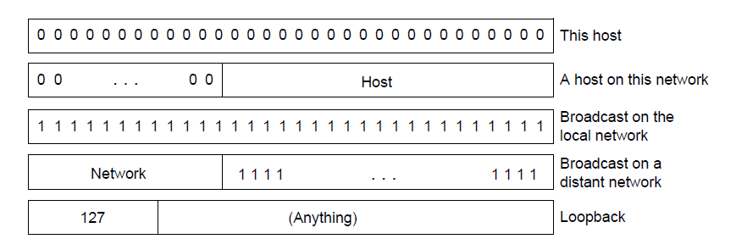
IP Addresses
Special IP addresses

Slide 64
Network Address Translation
More customers than the number of hosts, it has a problem!
  Dynamically assign an IP address
    Does not work well for business customers
The long-term solution is for whole Internet to migrate to IPv6
  128 bit addresses
Quick fix widely used today is NAT
  Translation from unique internal IP address to the shared public IP address takes place

Slide 65
Network Address Translation
  Three range of Private IP addresses:
    10.0.0.0 - 10.255.255.255/8 (16,777,216 hosts)
    172.16.0.0 - 172.31.255.255/12 (1, 048, 576 hosts)
    192.168.0.0 - 192.168.255.255/16 (65,536 hosts)

Slide 66
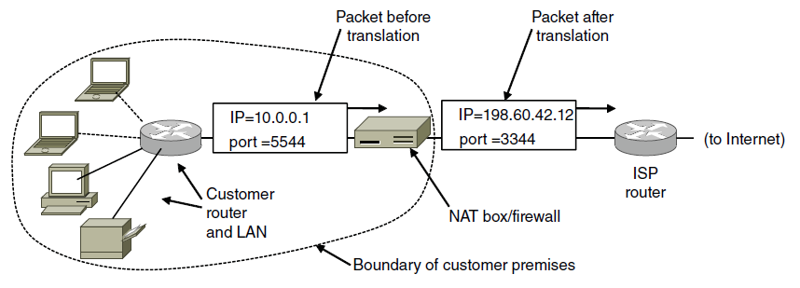
Network Address Translation
Placement and operation of a NAT box.

Slide 67
IP Version 6 Goals
Support billions of hosts
Reduce routing table size
Simplify protocol
Better security
Attention to type of service
Aid multicasting
Roaming host without changing address
Allow future protocol evolution
Permit coexistence of old, new protocols. . .

Slide 68
IP Version 6 Goals
IPv6 has longer addresses than IPv4
It contains only seven fields in the header
  Faster processing at routers
Better support for options.
Big advance is in security.
More attention paid to Quality of Service.

Slide 69
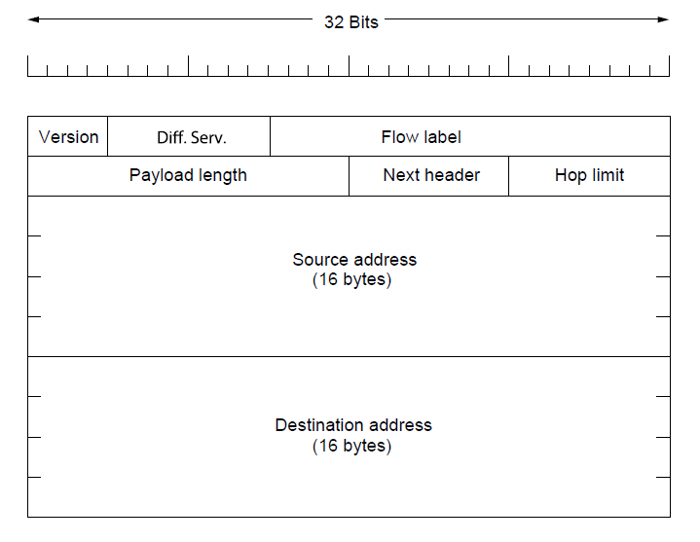
IP Version 6
The IPv6 fixed header (required).

Slide 70
IP address
8000:0000:0000:0000:0123:4567:89AB:CDEF
Now becomes
8000::123:4567:89AB:CDEF

Slide 71
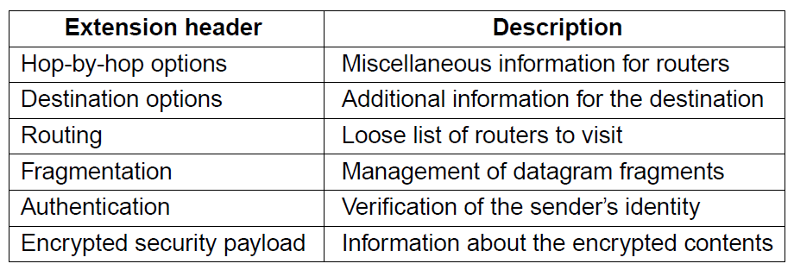
IP Version 6
IPv6 extension headers

Slide 72
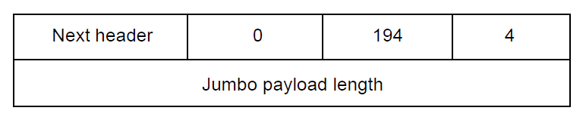
IP Version 6
The hop-by-hop extension header for
large datagrams (jumbograms).

Slide 73
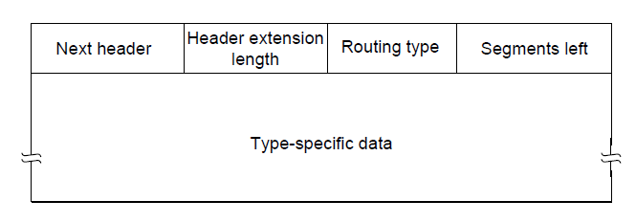
IP Version 6
The extension header for routing.

Slide 74
Internet Control Protocols
Internet has several companion control protocols used in the network layer.
  ICMP, ARP, and DHCP

Slide 75
Internet Control Message Protocol
Unexpected events occurred during the packet processing at a router, are reported to the sender using ICMP.
  Used to test Internet.
  Carried encapsulated in an IP packet.

Slide 76
Internet Control Message Protocol
Destination unreachable
  Router cannot locate the destination
  Packet with DF bit cannot be delivered.
Time Exceeded
  Packet is dropped when TtL has reached zero
  Traceroute utility
    TtL of 1, 2, 3, and so on, to know about the IP addresses of routers on the path

Slide 77
Internet Control Message Protocol
Parameter Problem
  Illegal value has been detected in the header field.
  Bug in the sending host’s IP software
Source Quench
  Throttle hosts that were sending two many packets
  Rarely used anymore
  Congestion is largely handled in the transport layer of Internet.

Slide 78
Internet Control Message Protocol
Redirect
  A packet seems to be routed incorrectly
  Tell the sending host to update to a better route
ECHO and ECHO REPLY
  ping utility
    Destination is reachable and currently alive.

Slide 79
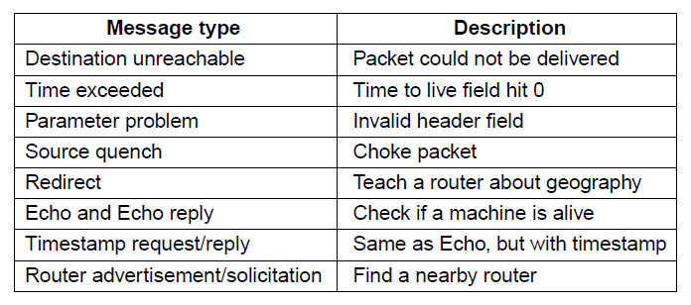
Internet Control Message Protocol
The principal ICMP message types.

Slide 80
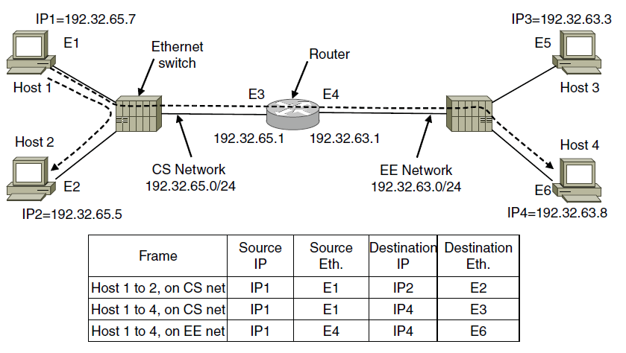
ARP- The Address Resolution Protocol
Two switched Ethernet LANs joined by a router

Slide 81
DHCP-The Dynamic Host Configuration Protocol
ARP assumes that hosts are configured with their own IP addresses.
  How do hosts get this information?
    Manually configure each computer, but tedious and error-prone.
  Network must have a DHCP Server
    Computer broadcasts a request for an IP address on its network
    DHCP DISCOVER packet
    DHCP server allocates a free IP address and sends it in a DHCP OFFER packet

Slide 82
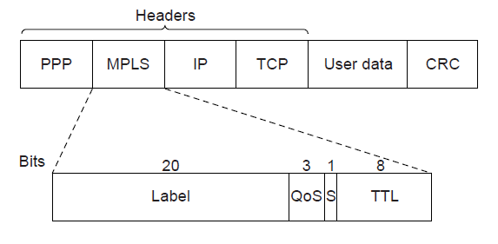
Label Switching and MPLS
Transmitting a TCP segment using IP, MPLS, and PPP.

Slide 83
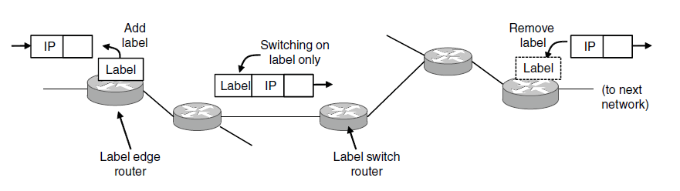
Label Switching and MPLS
Forwarding an IP packet through an MPLS network

Slide 84
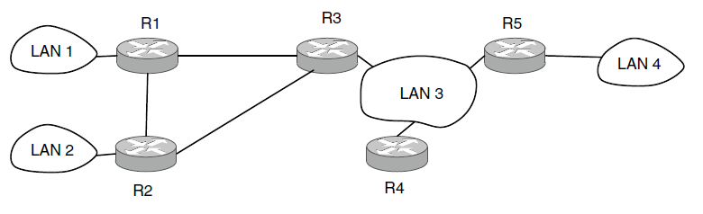
OSPF—An Interior Gateway Routing Protocol
Internet is made up of a large number of independent networks or ASes (Autonomous Systems)
  Intradomain routing can be used inside
  Also called as interior gateway protocol
An autonomous system

Slide 85
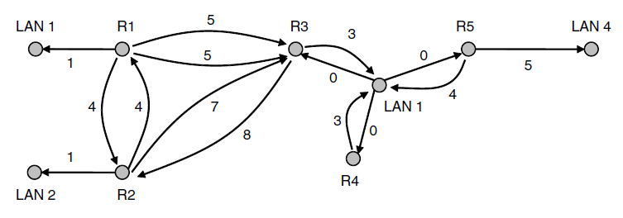
OSPF—An Interior Gateway Routing Protocol
A graph representation of the previous slide.

Slide 86
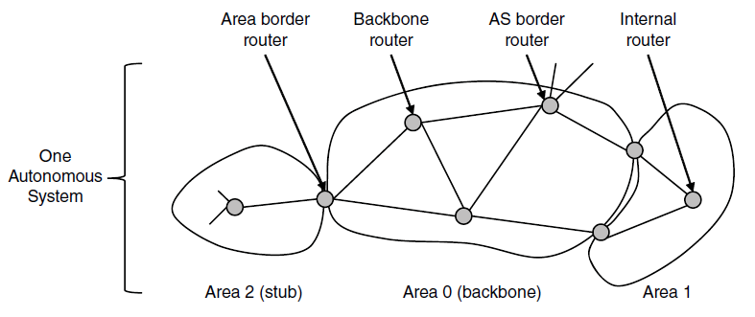
OSPF—An Interior Gateway Routing Protocol
The relation between ASes, backbones, and areas in OSPF.

Slide 87
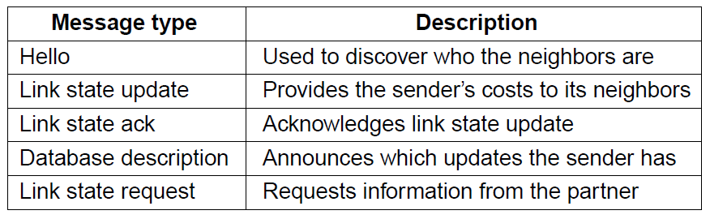
OSPF—An Interior Gateway Routing Protocol
The five types of OSPF messages

Slide 88
BGP—The Exterior Gateway Routing Protocol
Examples of routing constraints:
No commercial traffic for educat. network
Never put Iraq on route starting at Pentagon
Choose cheaper network
Choose better performing network
Don’t go from Apple to Google to Apple

Slide 89
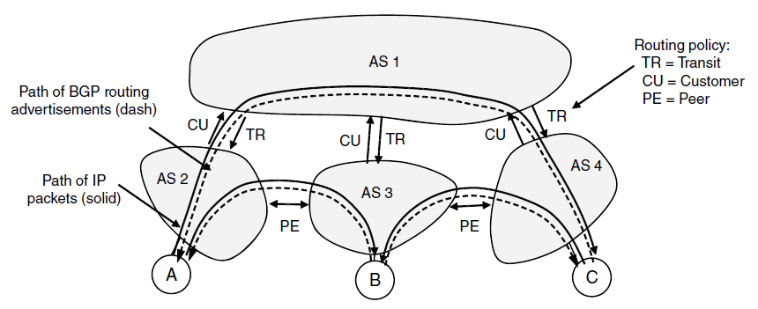
BGP—The Exterior Gateway Routing Protocol
Routing policies between four Autonomous Systems

Slide 90
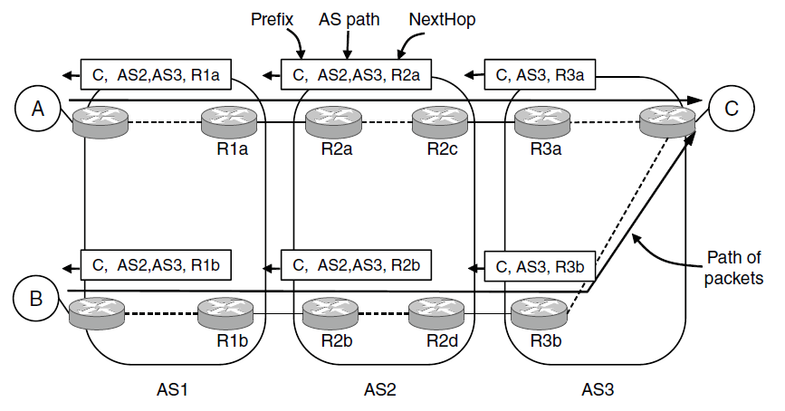
BGP—The Exterior Gateway Routing Protocol
Propagation of BGP route advertisements

Slide 91
Reference
Computer Networks, Fifth Edition by Andrew Tanenbaum and David Wetherall, Pearson Education-Prentice Hall, 2011

